Slide 1
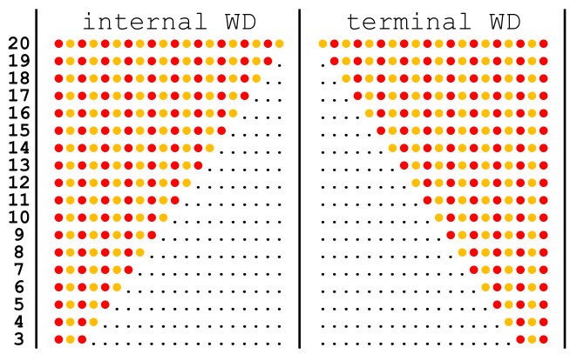
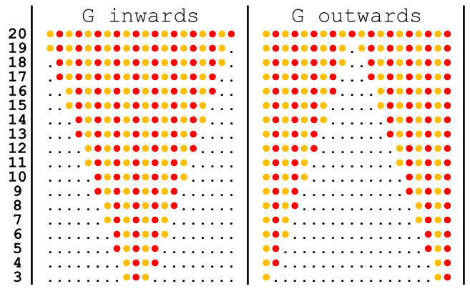
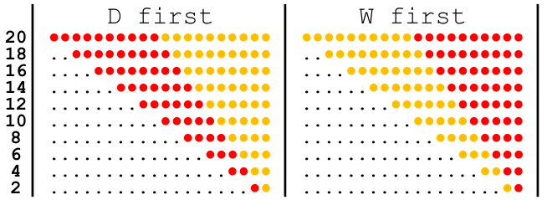
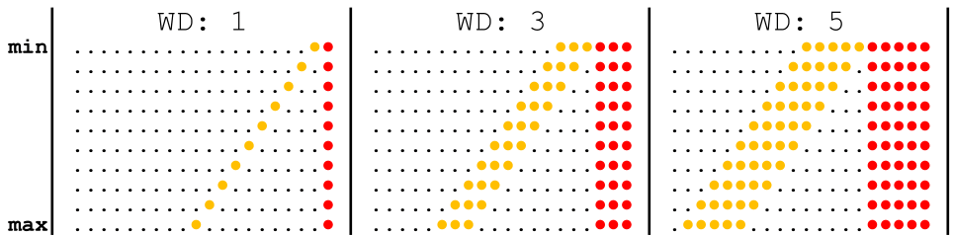
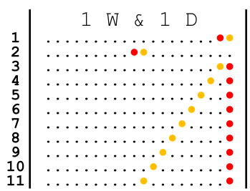
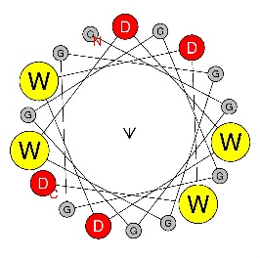
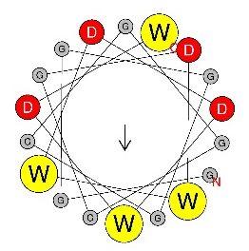
TO DO:
E - Change legend title to be more informative - change sequence legend to [1][2]..[5]
Sequence legends: need to move plot legends uniformly up to make room. And darken the red that is being used.
Fig. 1 Single W and single D is sufficient for functionality of AD.
A
B
C
Exp. setup
D
E
F
G
GGGGGGGGGGGGWDWDWDWD – -1.13
GGGGGGGGGGGGDWWDDWDW – 1.11
Figure 1. Single W and single D is sufficient for functionality of AD. A – experimental setup: oligo pool synthesis, cloning in bacteria, transformation in yeast, screening for growth phenotype, isolation of pool DNA, NGS sequencing, data analytics. B – X axis: individual sequences indicated in the inset table, where black dotes represent glycine, yellow dots represent tryptophan, and red dotes represent aspartic acid residues, Y axis: Log2 growth slope. C, D, E, F – same as B representing alternative sequences. G – indicated sequences with Log2 growth slope and images of the α-helix frontal view for corresponding sequence.

Slide 2
Fig. 2 Intermixing of acidic and aromatic residues is beneficial for function.
TO DO:
For D and F
- Change WD motifs to [WYF][DE]
A
B
D
W = 6 D = 6
C
WYF = 6 DE = 6
E
Functional tAD %
F
Functional tAD %
G
ML Features | ROC AUC
aa | 0.61
aa x pos | 0.72
tetrapep | 0.78
tetrapep x pos | 0.82
Tetrapep x position + balance | 0.87
Tetrapep x position (Hahn) – predict wd12 | 0.67
Shallow NNet | 0.90
Figure 2. Balance and intermixing of acidic and aromatic residues is beneficial for function. A – X axis: balance score calculated using formula N=nW-nD, Y axis: % of functional sequences in the pool of sequences containing all combinations of W and D for 12 positions (3968 sequences total). B – X axis: mixing score calculated using formula N =n(WD)+n(DW), Y axis: % of functional sequences in the pool of sequences containing all combinations of 6 W and 6 D (???? sequences total). C – X axis: mixing score calculated using formula N=n( [WYF][DE] ) + n( [DE][WYF] ), Y axis: % of functional sequences in the pool of sequences from Gcn4 random peptide library with 6 [WYF] and 6 [DE] (???? sequences total). D – X axis: % of functional sequences in the pool of sequences that contain a certain tetrapeptide motif, Y axis: tetrapeptide motifs (red dot = D for wd12 and [DE] for Gcn4, orange dot = W for wd12 and [WYF] for Gcn4. E – X axis: Starting amino acid position of tetrapeptide in tAD module, Y axis: 16 sequence combinations for tetra-peptides containing D and W, Tile fill: % of functional sequences in the pool of sequences that have a certain motif at a certain position. F – X axis: Starting amino acid position of tetrapeptide in tAD module, Y axis: 16 sequence combinations for tetra-peptides containing [DE] and [WYF], Tile fill: % of functional sequences in the pool of sequences that have a certain motif at a certain position. G – ML accuracy on hold out testing set measured with ROC AUC.

Slide 3
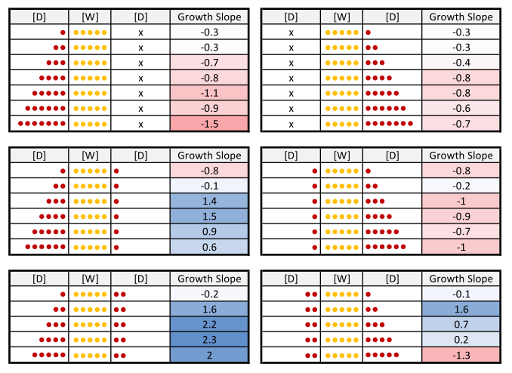
Fig. 3 Ds flanking W cluster is beneficial for AD functionality.
Note on starred sequences:
3D – 5W – 2D: highest functionality of every sequence with 5D and 5W
4D – 5W – 2D: highest functionality of every sequence with 6D and 5W
5D – 5W – 2D: highest functionality of every sequence with 7D and 5W
** 3D – 5W – 2D: highest functionality of entire WD10 combinatorial pool.
A
B
C
Following amino acids (end caps)
Following amino acids (end caps)
D
Figure 3. General end position of Ws or Ds flanking W cluster is beneficial for AD functionality.
A – X axis: position of D (red line) or W (yellow line) within the sequence, Y axis: % of functional sequences in the pool of sequences containing all combinations of W and D for 12 positions (3968 sequences total). B – Y axis same as in A, X axis: size of W cluster preceding indicated end cap for sequences representing each line. C – same as B calculated for (Hahn’s) library using [W, F, Y] instead of just W and [D,E] instead of just D. D - sequences with indicated growth slopes. Red dots represent D and yellow dots represent W.

Slide 4
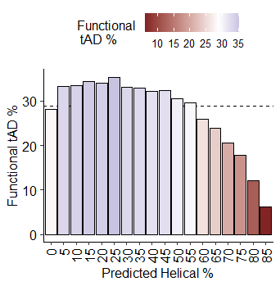
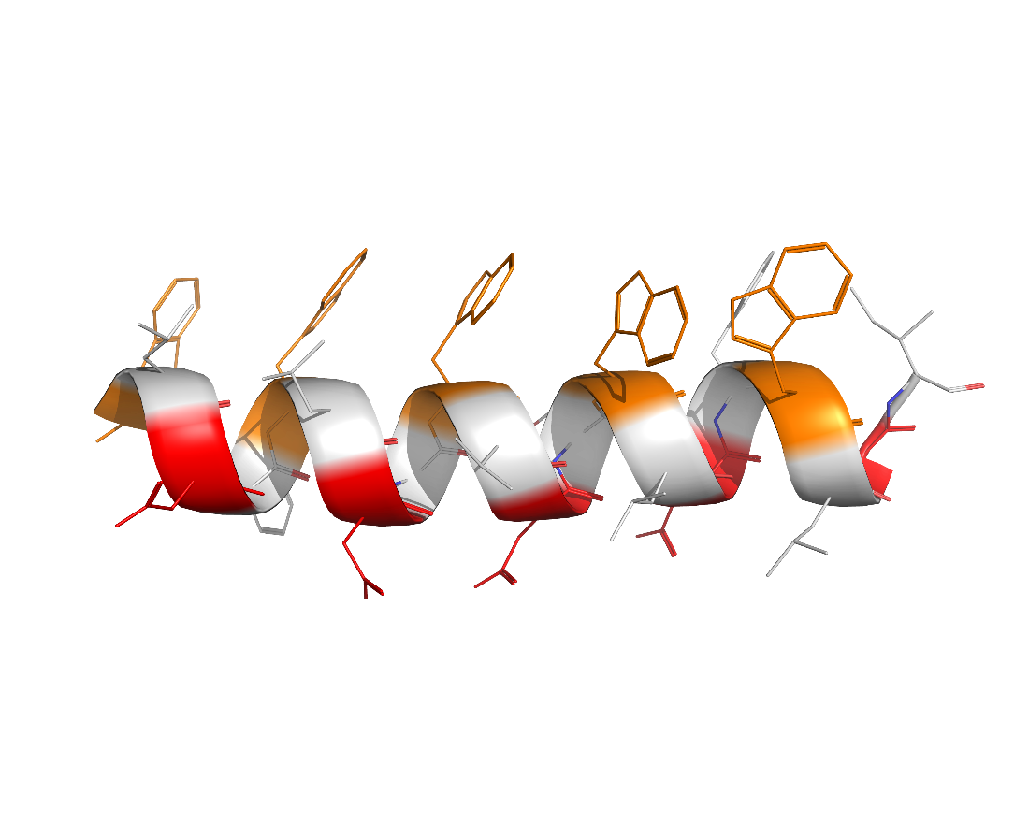
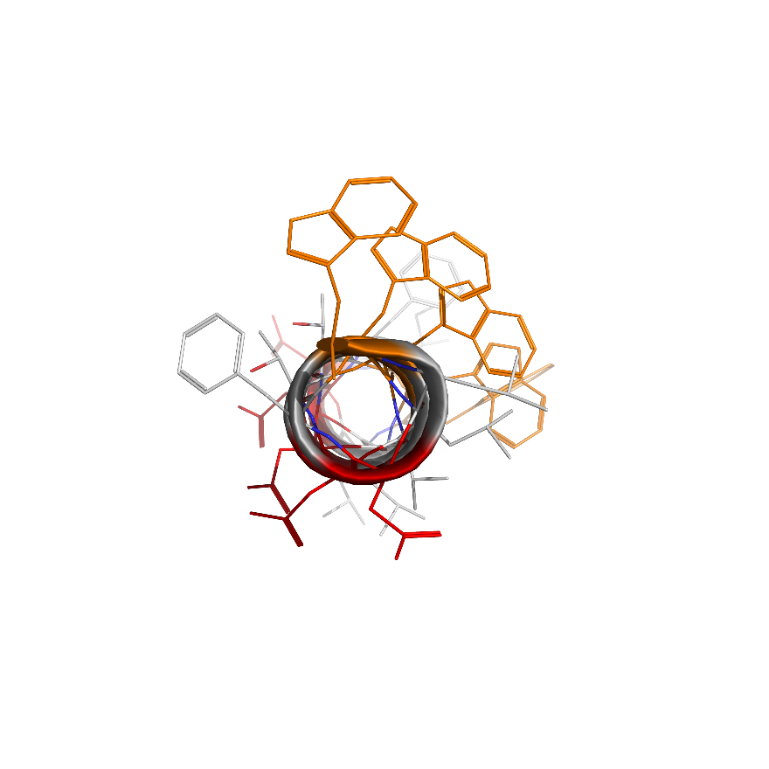
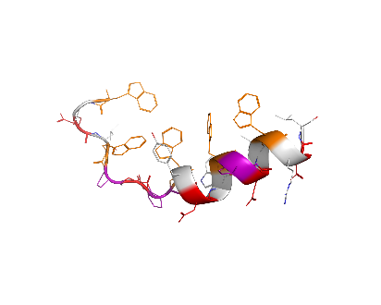
Fig. 4 Formation of the amphipathic α-helix is generally detrimental for AD functionality, while insertion of proline in it is beneficial.
To do:
Rerun C to be wider
D – run alphafold predictions and pymol model of remaining proline count sequences
Add proline in Hahn and kornberg
** Proline sequences are all functional here. This is only a demonstration of disorder increasing functionality
1p - WFDSWADIWGDLWPDSWGDL
2p - WFDLWPDLWTDPWIDCWLDV
3p - have it
4p - WYDPWPDNWMDPWSDKWTDP
5p - WVDPWPDLWLDPWRDIWPDP
6p - WYDSWPDPWPDPWKDSWPDP
A
B
W.D.W.D.W.D.W.D.W.D.
C
D
0
1
2
3
Figure 4. Formation of the amphipathic α-helix is generally detrimental for AD functionality, while insertion of proline in it is beneficial.
A – graphical representation of sequences for the WD5 library, each member of which has five Ws, five Ds, and ten random amino acids between Ws and Ds represented by black dots/circles. B – Y axis: % of functional sequences in the WD5 library. X axis: % of α-helix predicted by SPOT-1D algorithm for each set of sequences from WD5 library. C – Y axis: % of functional sequences. X axis: count of corresponding amino acid residues between Ws and Ds of WD5 library. D – 3D structures of sequences with varying number of proline residues.

